Slide 1

Constraining models of uncertainty with data
Modeling Uncertainty in the Earth Sciences
Jef Caers
Stanford University

Slide 2
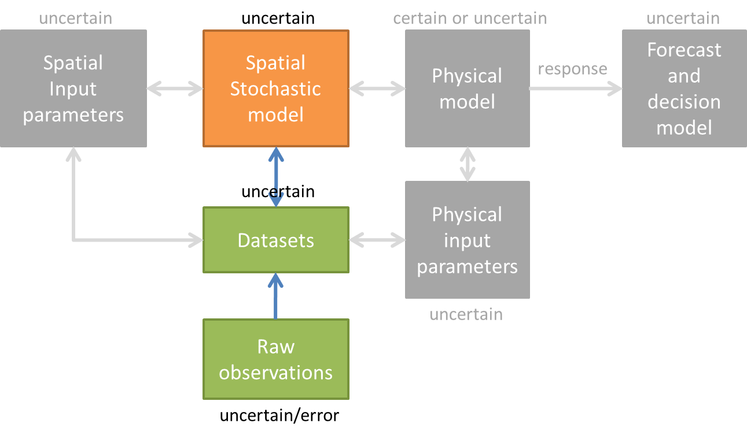
Modeling Uncertainty in the Earth Sciences

Slide 3
Data
Constraining spatial models of uncertainty with data

Slide 4
Geophysical measurements
processing
Most other geophysical/remote sensing methods rely on this principle,
they just rely on different physical equations

Slide 5
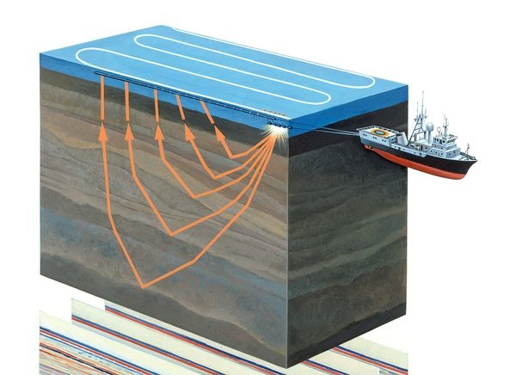
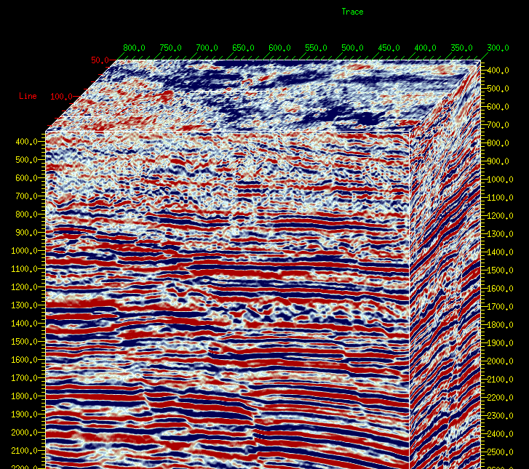
Sea-based seismic

Slide 6
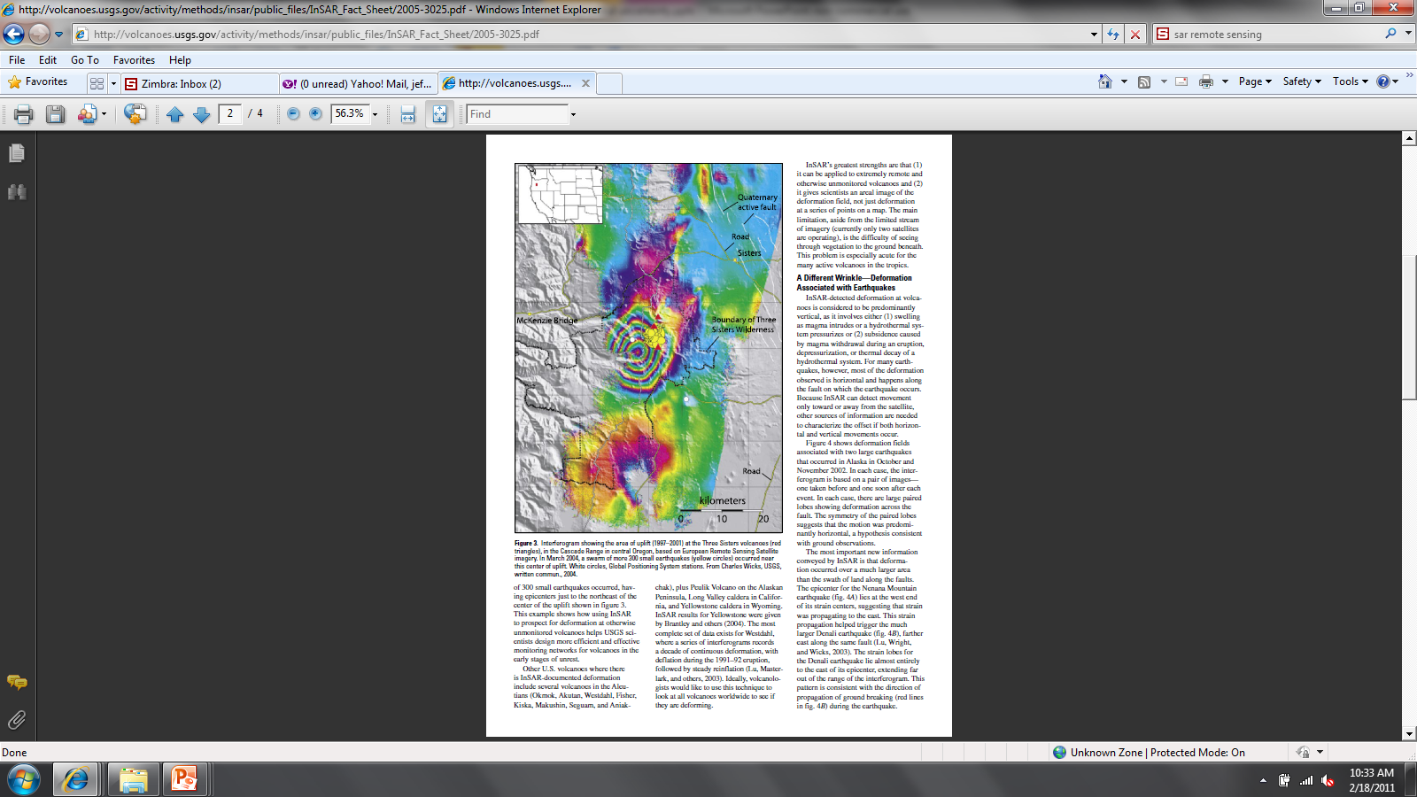
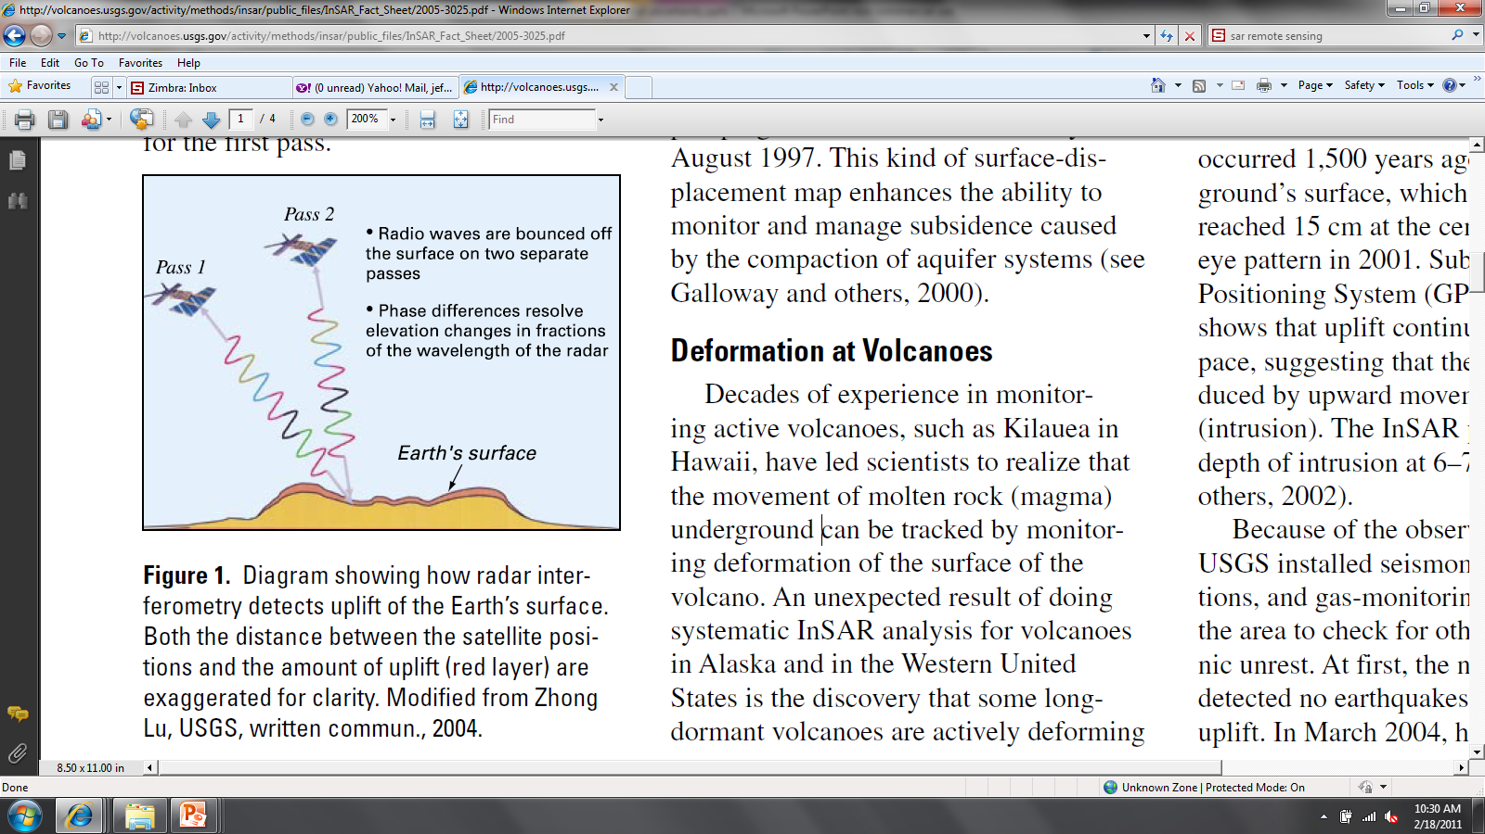
inSAR: interferometry synthetic aperture radar

Slide 7
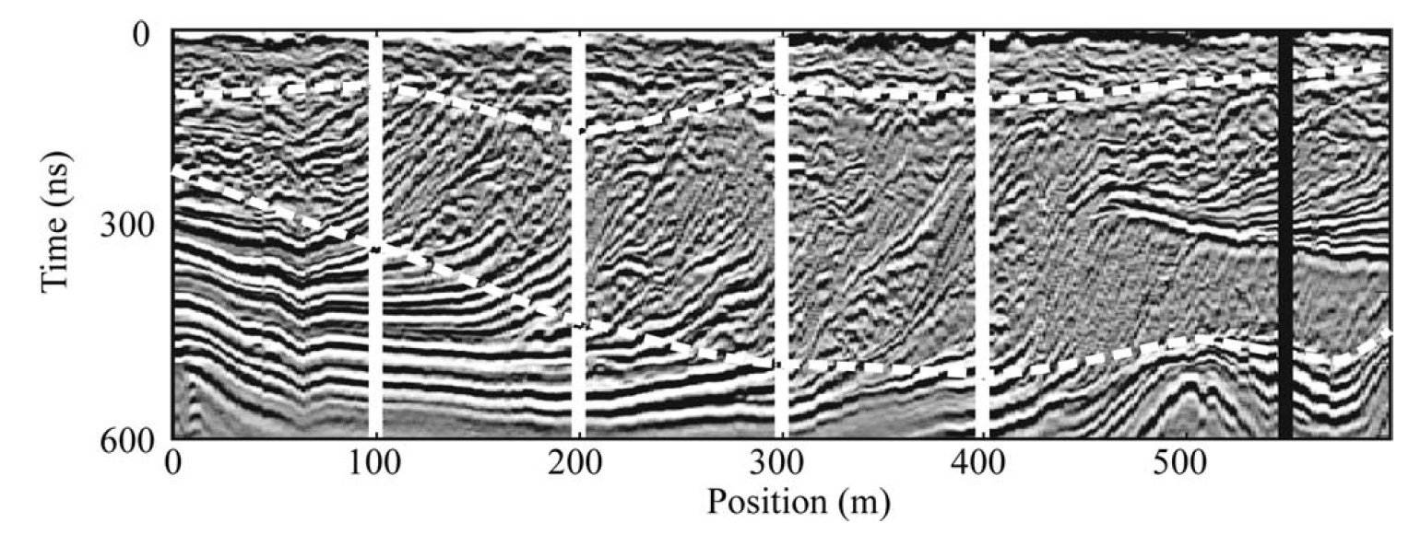
Ground penetrating radar
A50-MHz radar section from the William River delta

Slide 8
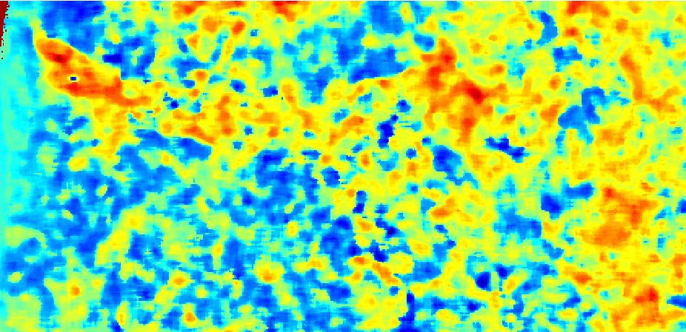
What information does this data bring?
Plan-view on 3D processed seismic data

Slide 9
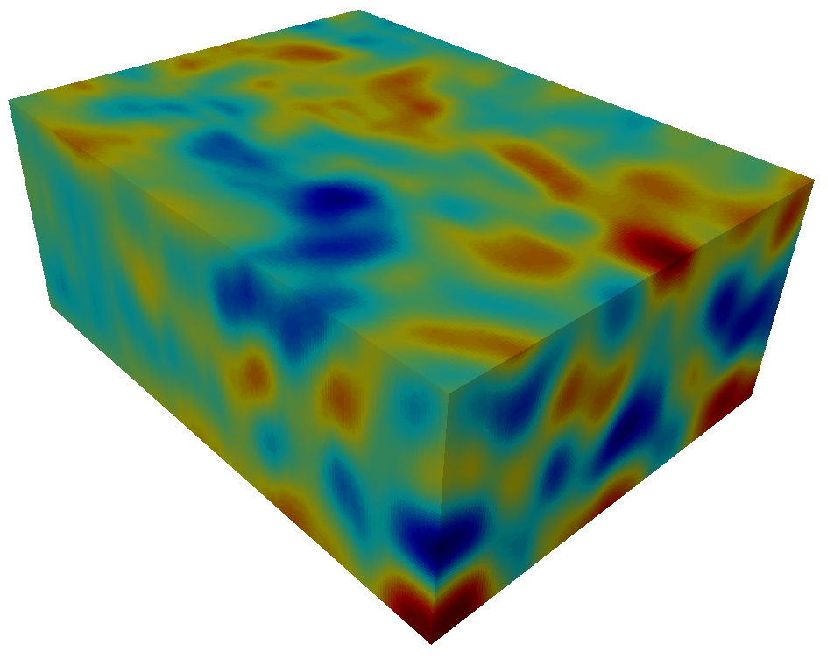
Scale of information
Geophysical data
Channel complex

Slide 10
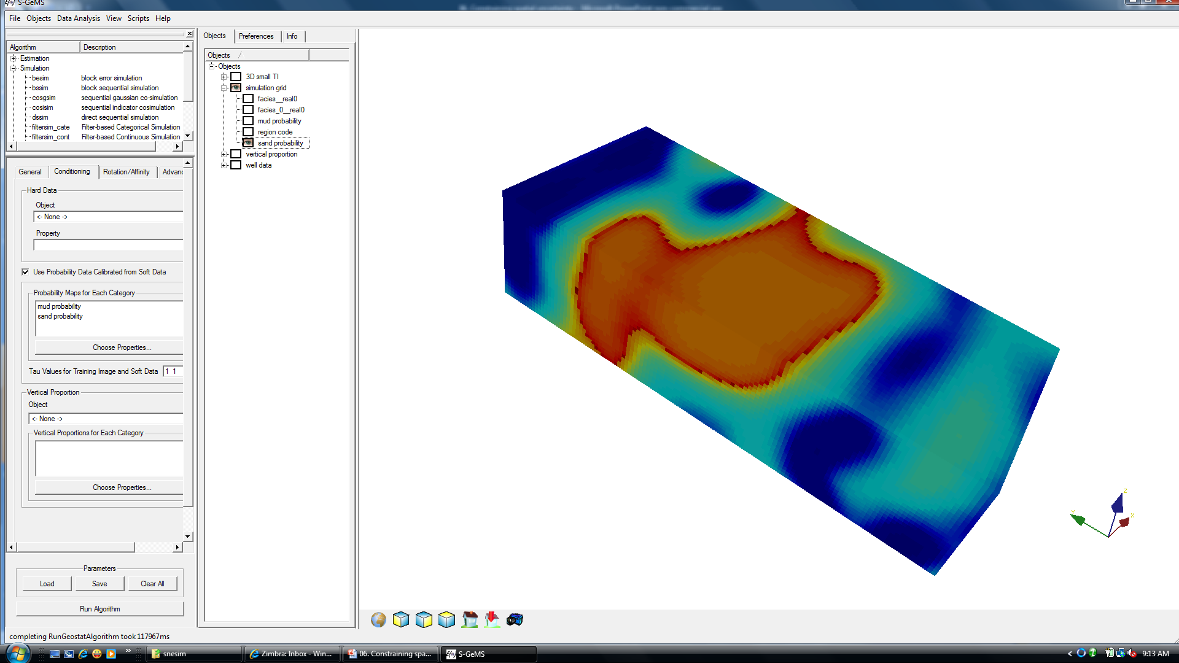
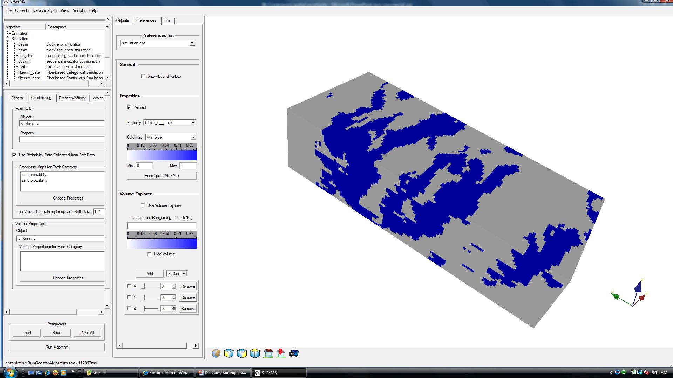
Scale of information
Property measured by 3D seismic
Actual subsurface variability

Slide 11
Questions that we will address
How to use data sources such as geophysical measurements to reduce uncertainty ?
How to account for the “partial information” that such data sources provide
How to combine several data sources (e.g. wells with seismic), each providing only partial information

Slide 12
Probability-based methods
Constraining spatial models of uncertainty with data

Slide 13
Calibration and integration
Problem statement: one has several data sources, each providing information about some 3D spatial variation
Step 1: Calibration = how much information is contained in each data source ?
Step 2: Integration = how do we combine these sources of information

Slide 14
Calibration
How can we model the information content a data source has on some unknown ?
Answer = a conditional probability, why ?
P(A|B) where A = target unknown and B = information source models the remaining uncertainty on A when knowing B
Note: the degree of uncertainty is always with respect to having no data P(A) (and P(A) does not have to be 0.5!)
What is needed to perform such calibration ?

Slide 15
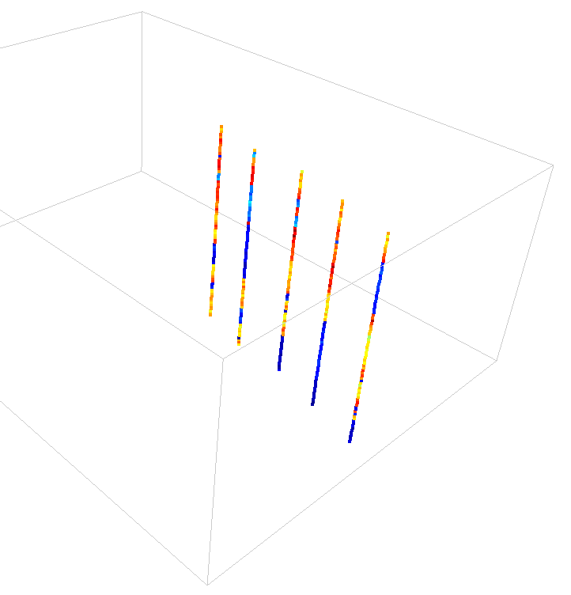
Data for calibration
To determine P(A|B) you need joint information on (A,B), i.e. you need data pairs (a_{i}, b_{i}), i = 1,…,n

Slide 16
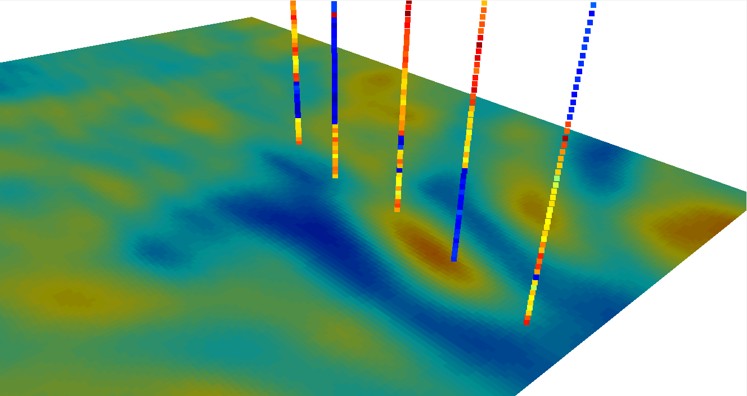
Data for calibration

Slide 17
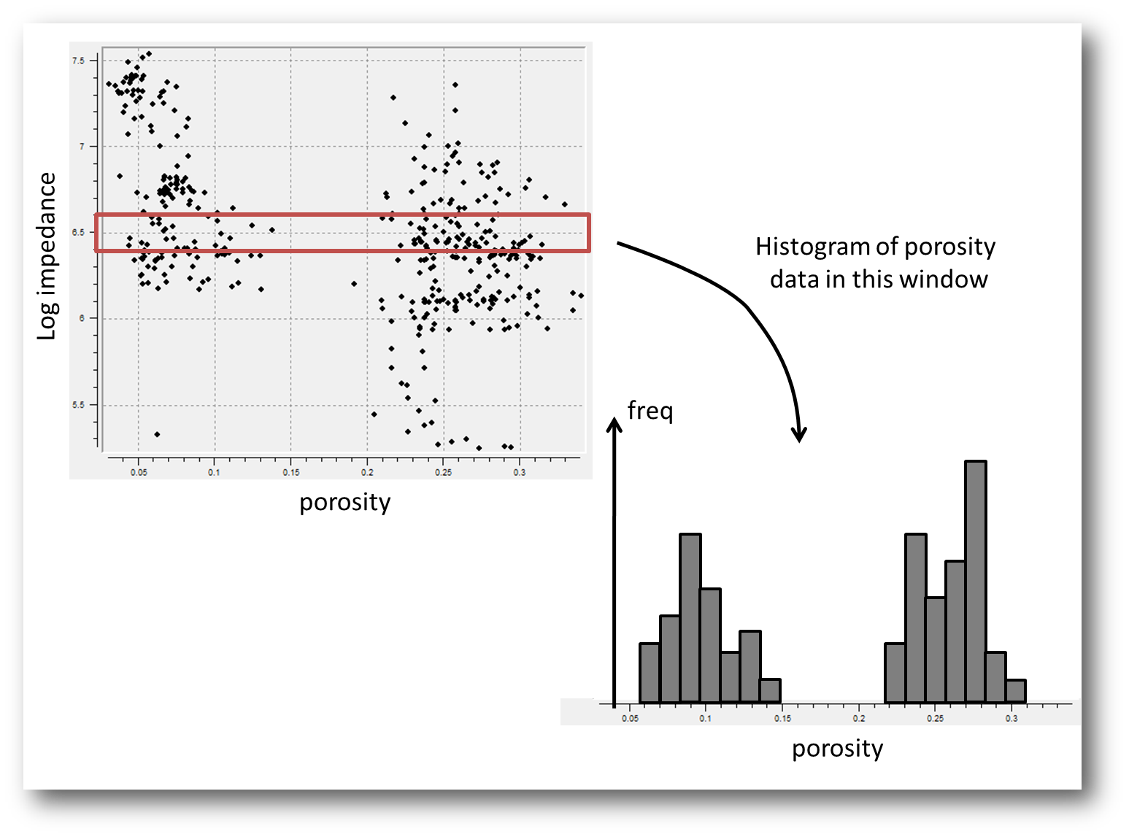
Example 1: scatter plots
One can derive a conditional probability from a scatter plot

Slide 18
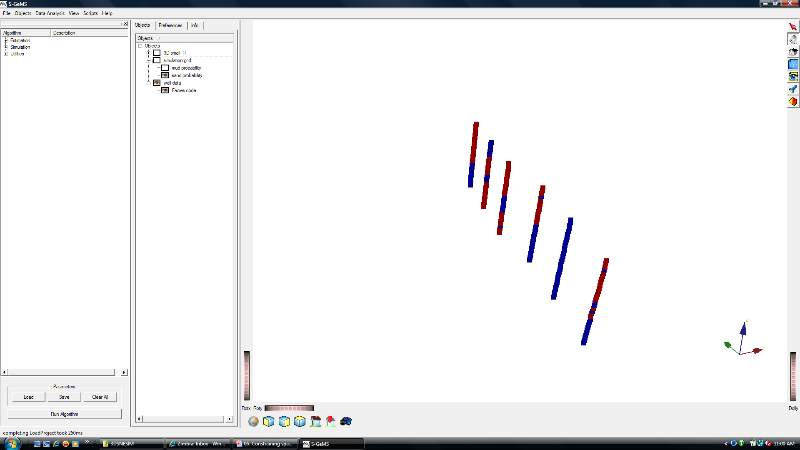
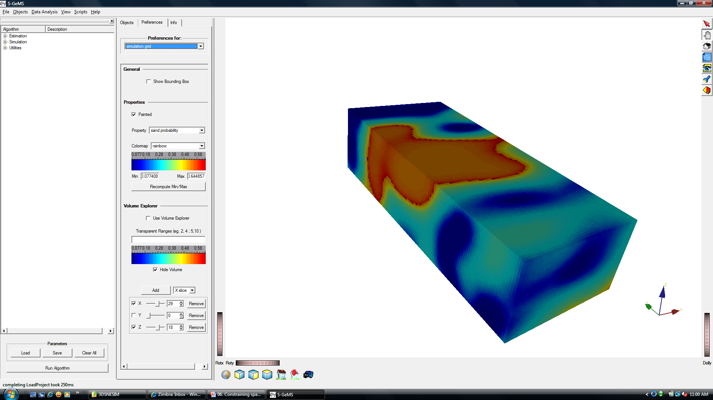
For discrete variables

Slide 19
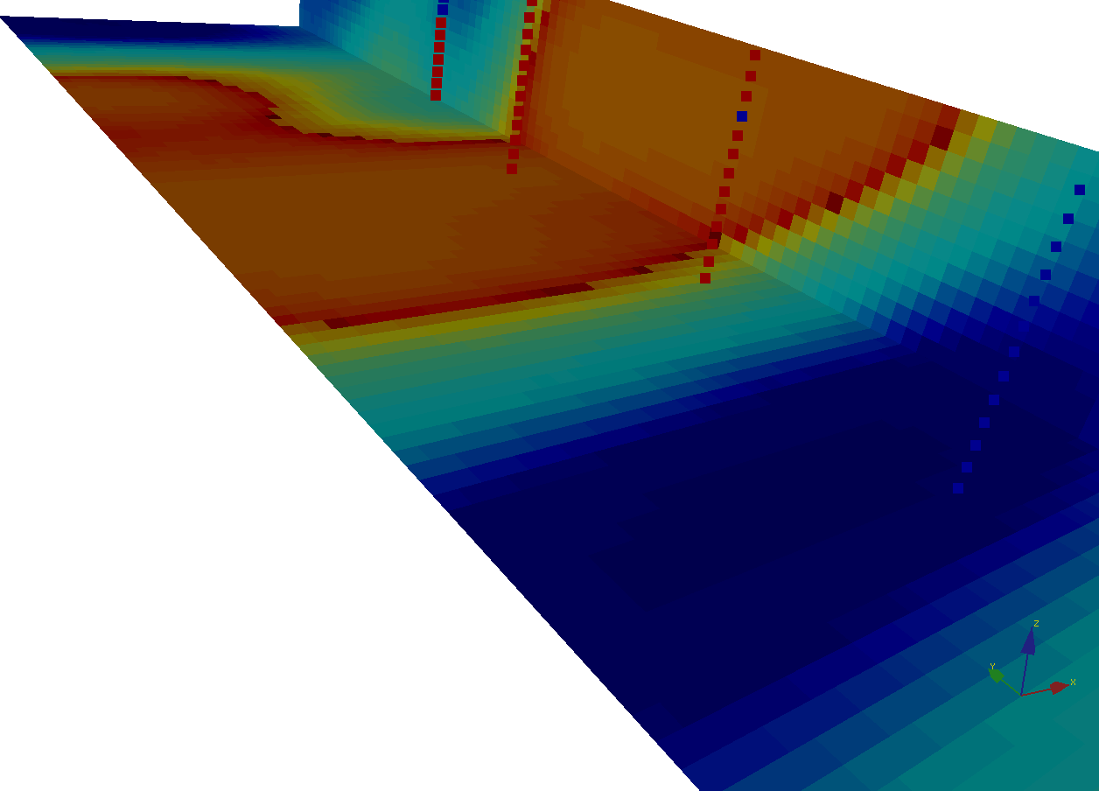
For discrete variables
One can derive a conditional probability simply by counting (frequencies)

Slide 20
Calibration
Requires a calibration data set
Example 1: obtain such data from the field
Example 2: obtain such data from an analog field
Example 3: create such data by physical modeling

Slide 21
Integration of information content
Example problem: two sources of information (B₁ and B₂) tell you that the chance it will rain tomorrow (A) is significant, in fact,
The first sources B₁ says there is a probability of 0.7
The second source B₂ says there is a probability of 0.6
The “historical” probability of it raining tomorrow is 0.25
You know the two sources got their information differently
What is now the probability that it rains tomorrow?
Lower than 0.6?
Between 0.6 and 0.7?
Higher than 0.7?

Slide 22
Redundancy
Redundancy measures how much “overlap” there is in the sources of information. If there is complete overlap than the information sources are redundant (and you can throw one away)
Redundancy vs Dependency (association)
Redundancy is always with regard to a target (A=raining tomorrow)
Dependency is the degree of association between information sources B₁ and B₂ regardless of the target A
Redundancy is difficult to “measure”, it requires making assumptions about the nature of the information sources with respect to the target

Slide 23
Let’s make a hypothesis
The relative contribution of information B₂ to knowledge of A is the same regardless of the fact that you have information B₁
quantifies how much is not known about A
knowing the information B₁
quantifies how much is not known about A
knowing the information B₂
quantifies how much is not known about A
before any data is available
quantifies how much is not known about A
knowing the information B and C

Slide 24
Mathematical result
Hypothesis:
The contribution of information C to knowledge of A is the same regardless of the fact that you have information B
Relative contribution of C
to knowing A
without knowing B
=
Relative contribution of C
to knowing A
when B is available

Slide 25
Integration of information content
Example problem: two sources of information (B₁ and B₂) tell you that the chance it will rain tomorrow (A) is significant, in fact,
The first sources B₁ says there is a probability of 0.7
The second source B₂ says there is a probability of 0.6
The “historical” probability of it raining tomorrow is 0.25
You know the two sources got their information differently
Answer under the hypothesis = 0.91

Slide 26
Questions that we will address
How to use data sources such as geophysical measurements to reduce uncertainty ?
How to account for the “partial information” that such data sources provide
How to combine several data sources (e.g. wells with seismic), each providing only partial information

Slide 27
Integration with spatial uncertainty
Reservoir
Grid filled with
seismic derived facies probabilities : P(A|C)
From training image: P (A|B)
From seismic : P(A|C)
P(A|B,C) can be calculated

Slide 28
Case study

Slide 29
Geological concept

Slide 30
Probability from seismic

Slide 31


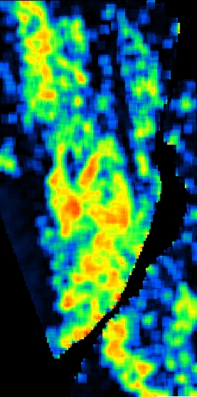
Using hard and soft data
Seismic-derived
sand probabilities
Hard data only
Hard + soft data
Average sand probability in simulated sand: 34.3%
Average sand probability in simulated no-sand: 9.9%

Slide 32

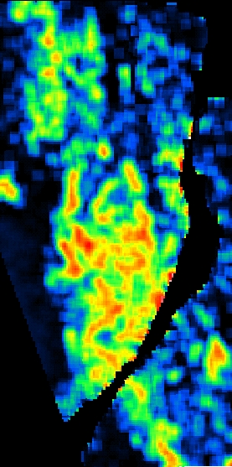

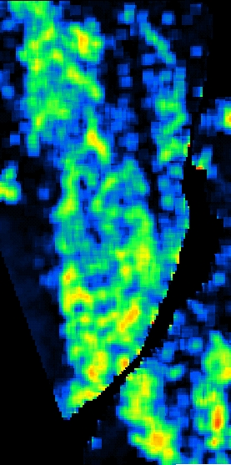
Depth variation
Reservoir Bottom
Reservoir Top
Seismic-derived
sand probability
Seismic-derived
sand probability
mps simulation
mps simulation

Slide 33
Variogram-based methods
Constraining spatial models of uncertainty with data

Slide 34
Data for calibration
Some other data source (e.g. geophysics)

Slide 35
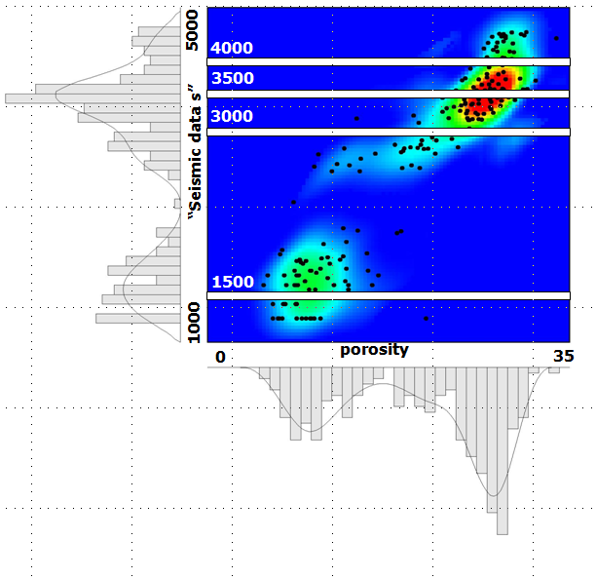
Easy calibration: correlation-coefficient
ρ=0.75
But: a correlation coefficient contains less information about the relationship between what you are trying to model and the data than a conditional probability

Slide 36
Expand kriging
Hard data
?
Collocated soft data
Set of weights will depend on
The variogram model
The correlation coefficient with the additional data

Slide 37
Example in S-GEMS

Slide 38
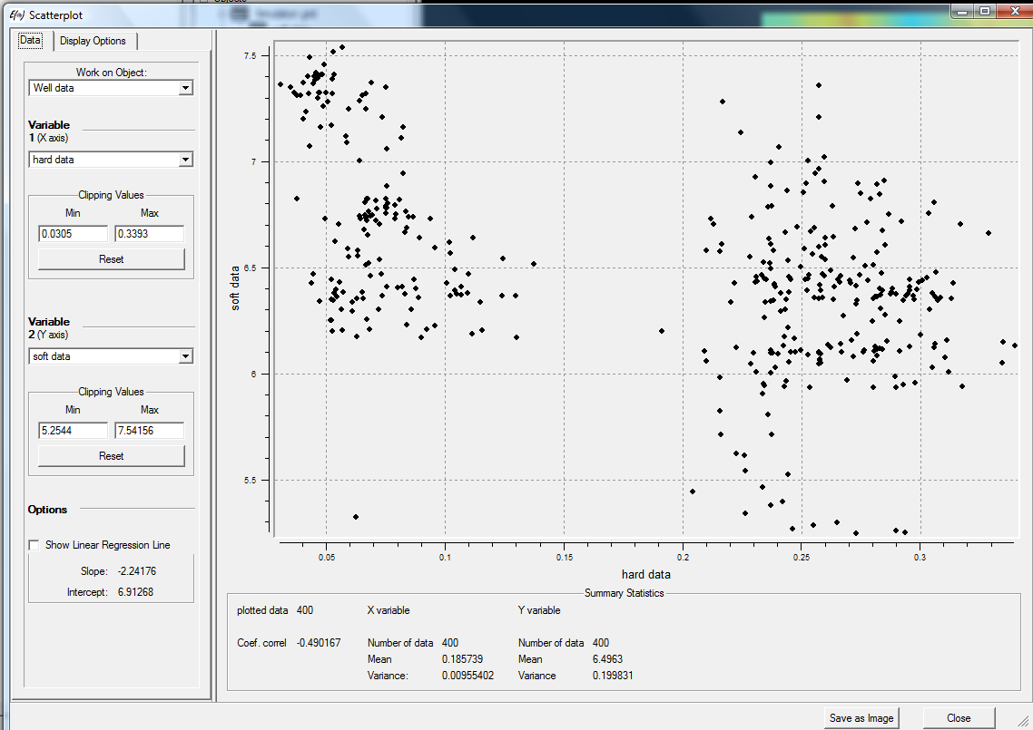
Correlation coefficient

Slide 39
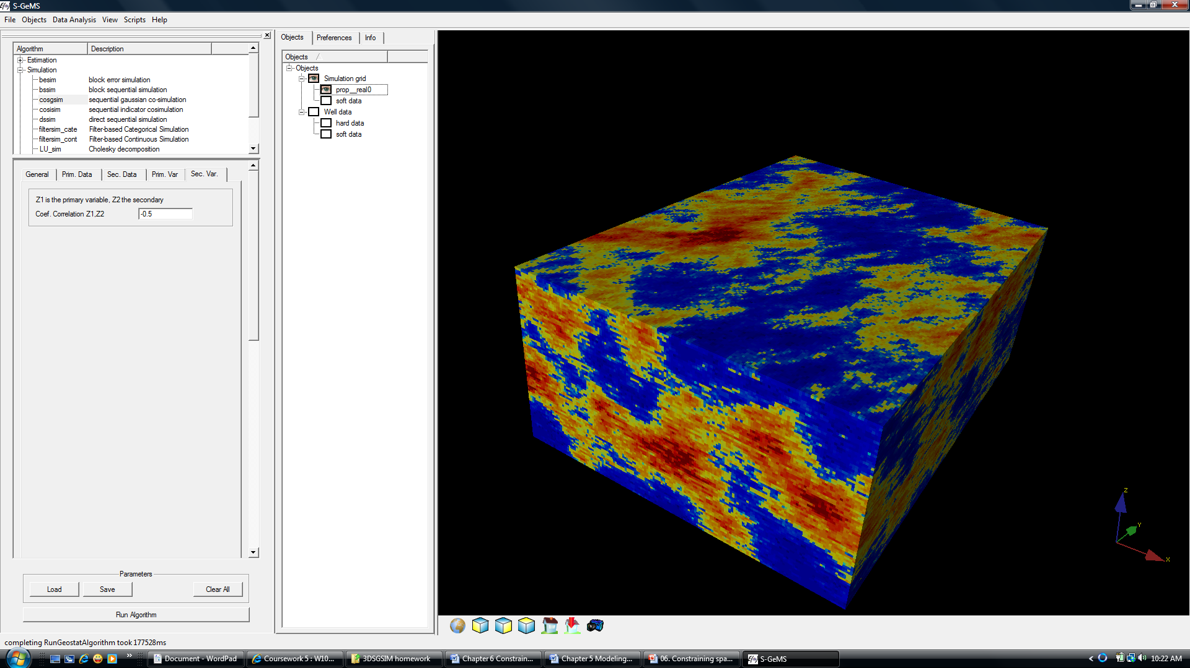
Co-SGSIM

Slide 40
Result

Slide 41
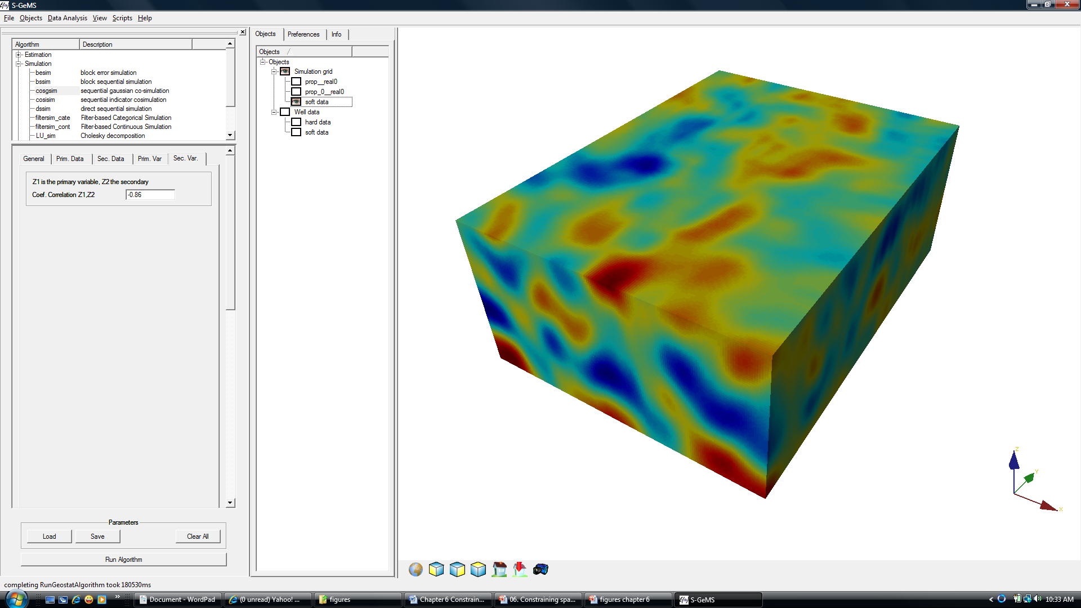
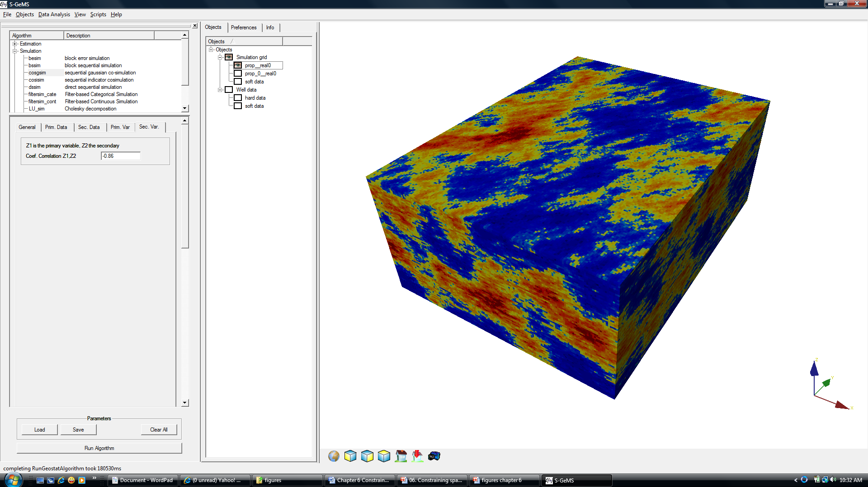

Change correlation to -0.85
Soft data
ρ=-0.49
ρ =-0.85

Slide 42
Inverse modeling
Constraining spatial models of uncertainty with data

Slide 43
Motivation
Probabilistic and variogram-based approaches ignore the physical relationship that exists between the measurement B and what we are determining A
Appears to be the logical choice
without any more information
A
Appears to be the logical choice
if relationship is periodic
B

Slide 44
Motivation
Some data cannot be turned into probabilities
Flow problem
The data
Injection
Production

Slide 45
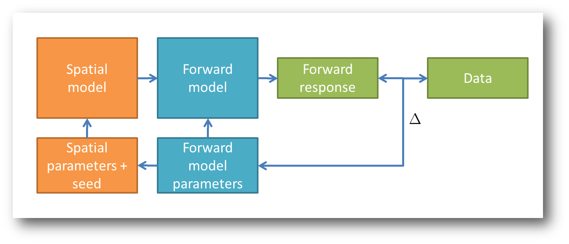
Elements of inverse modeling
The 3D Earth model
The forward model and response
Objective function
Perturbation (change) and iteration

Slide 46
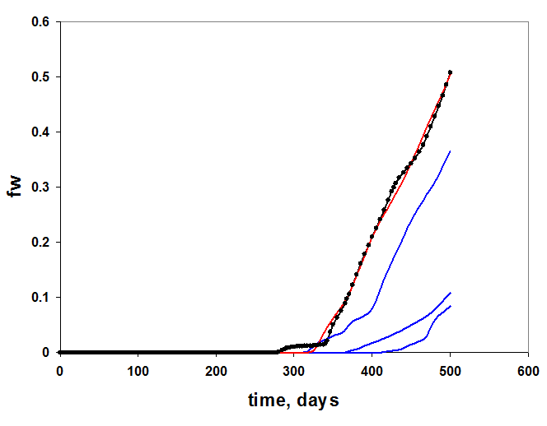
Example
P
I

Slide 47
What can we perturb?
The random numbers used to generate the Earth model
The input parameters used to create the Earth model
The physical parameters of the forward model
The initial and boundary conditions of the forward model
The physical law that determines the forward model
The data may not be exact, so exact matching may not be needed

Slide 48
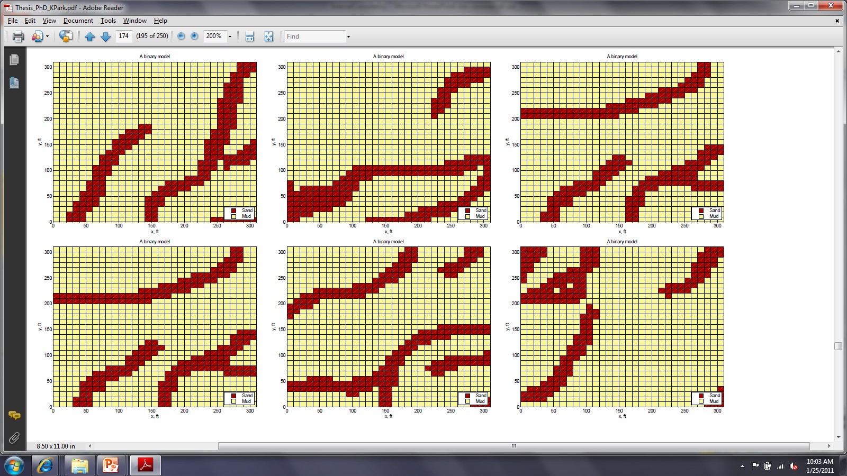
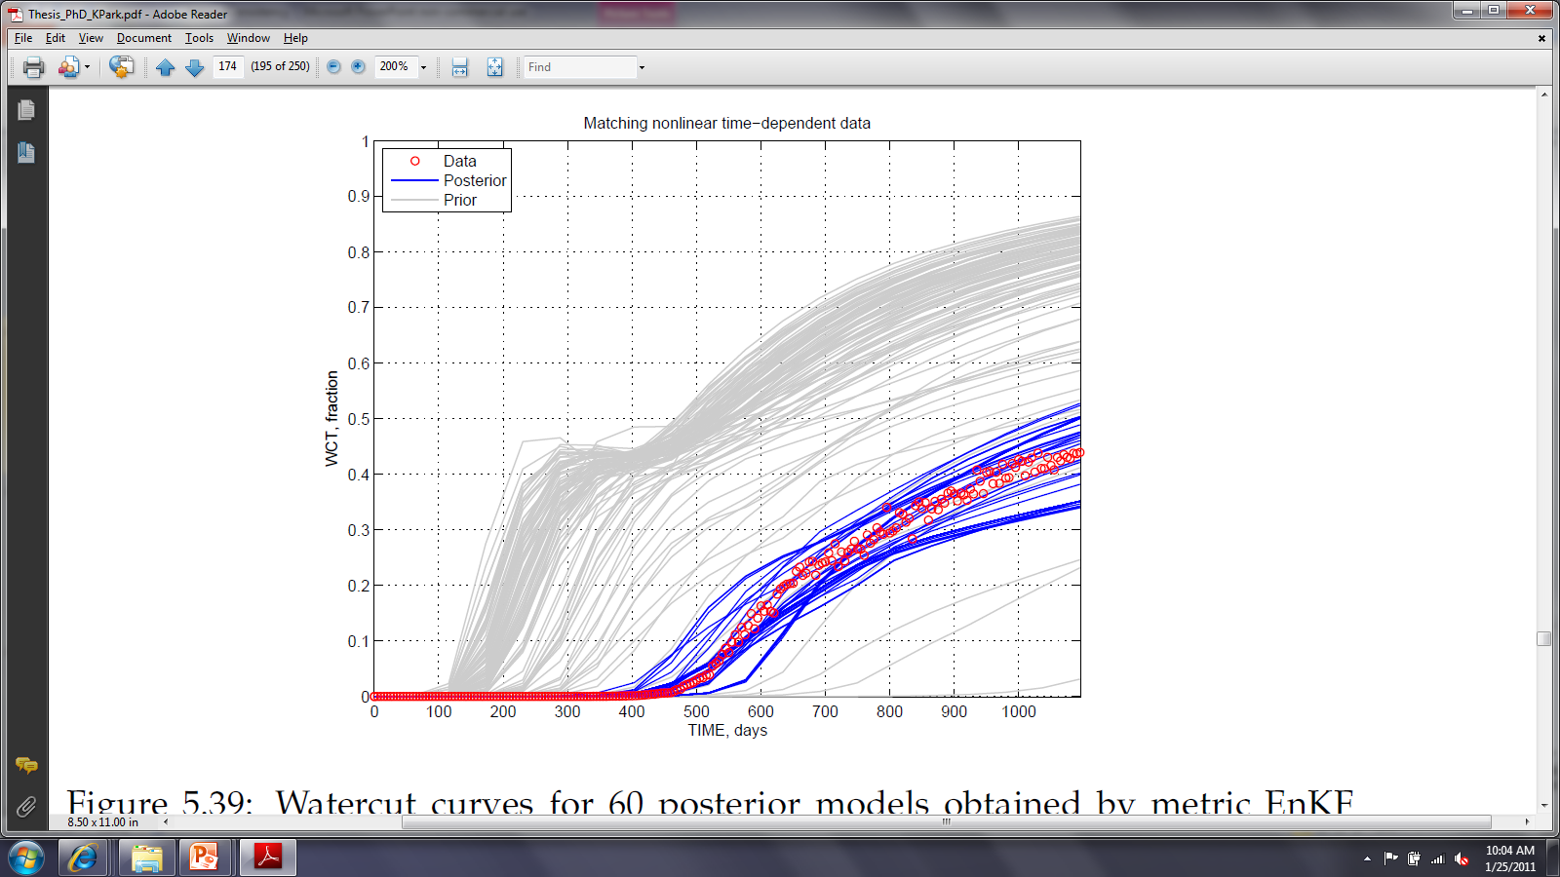
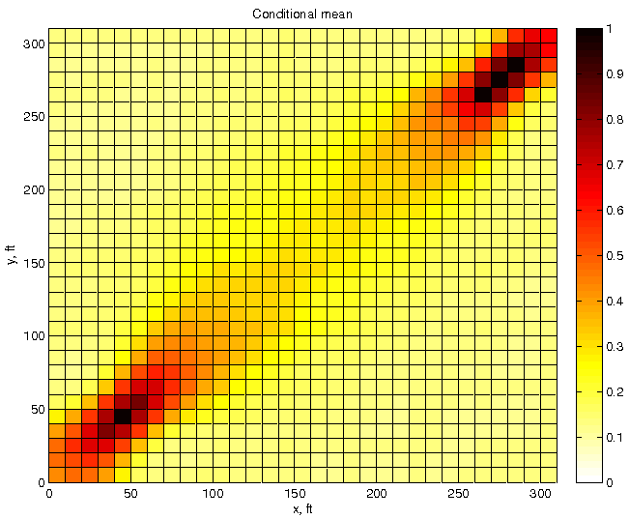
Many solutions are possible
A few possible Earth models
P
I
The ensemble average
of 30 Earth models

Slide 49
Uncertainty: Bayes’ rule
M = the uncertain Earth model
D = the possible data outcomes
m = some Earth model
d = some data outcome, namely the field data

Slide 50
Why does Bayes’ rule matter ?
M = the proportion of sand
The data: d=1
The forward model
The solutions
m=0; m=10 and m=20
are they equiprobable?
No!
P(M=0|d=1) = 0%
P(M=1|d=1) = 20%
P(M=2|d=1) = 80%

Slide 51
For those who read geostatistics books
Forget the term “equiprobable realizations”
It is awfully confusing !

Slide 52
What if there is “measurement error”?
What is measurement error ? If you repeat the measurement you get a different result
Measurement error depends on the magnitude of what you measure.
Modeled most generally using a conditional probability

Slide 53
Back to our example

Slide 54
Conclusion from Bayes’ rule
Solution to inverse problems depend on the prior probabilities associated with Earth models and on the data-variable relationship
The data-variable relationship can be uncertain and needs to be modeled as P(D|M)
There may be conflict between the prior probabilities and the data variable relationship

Slide 55
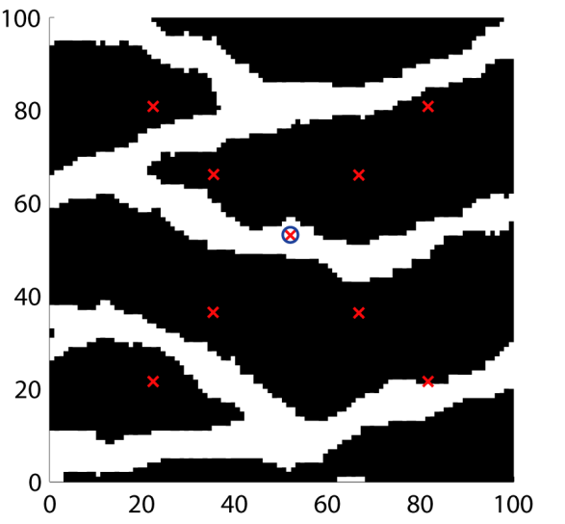
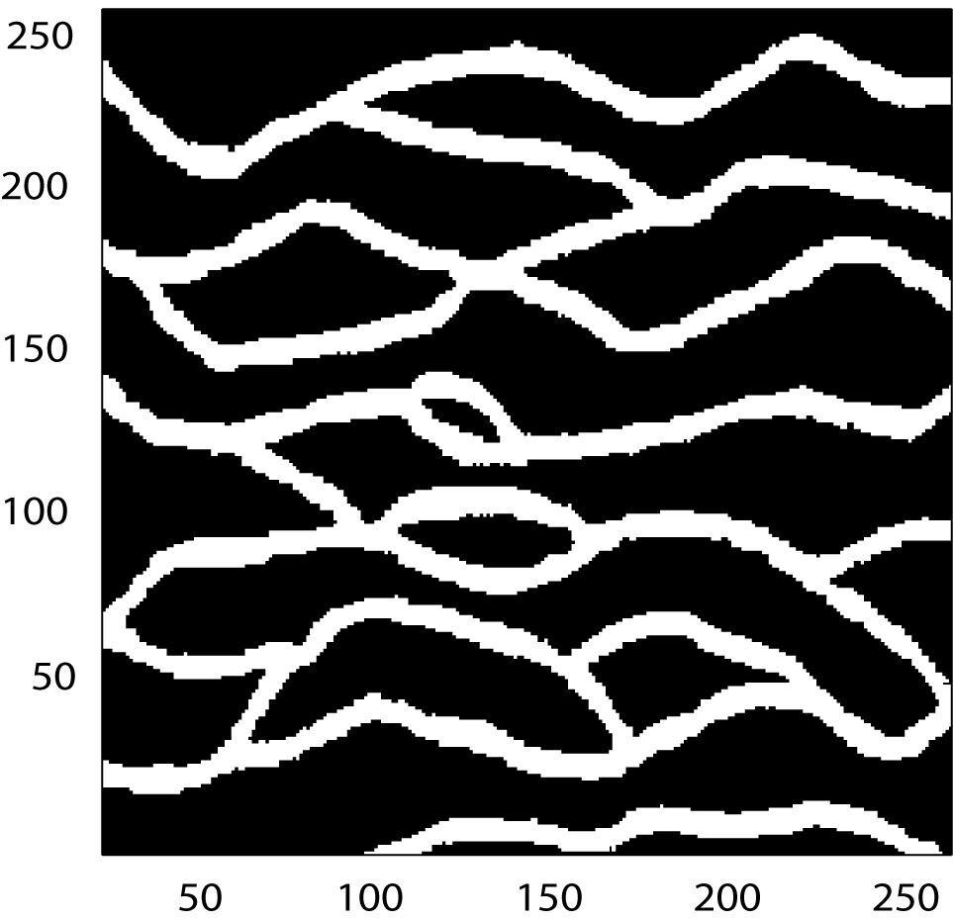
Solution methods
Data: pressure at 9 locations
Forward model: pressure simulation
Spatial model: training-image based
Reference “truth”

Slide 56
Prior models
Prior Earth models

Slide 57
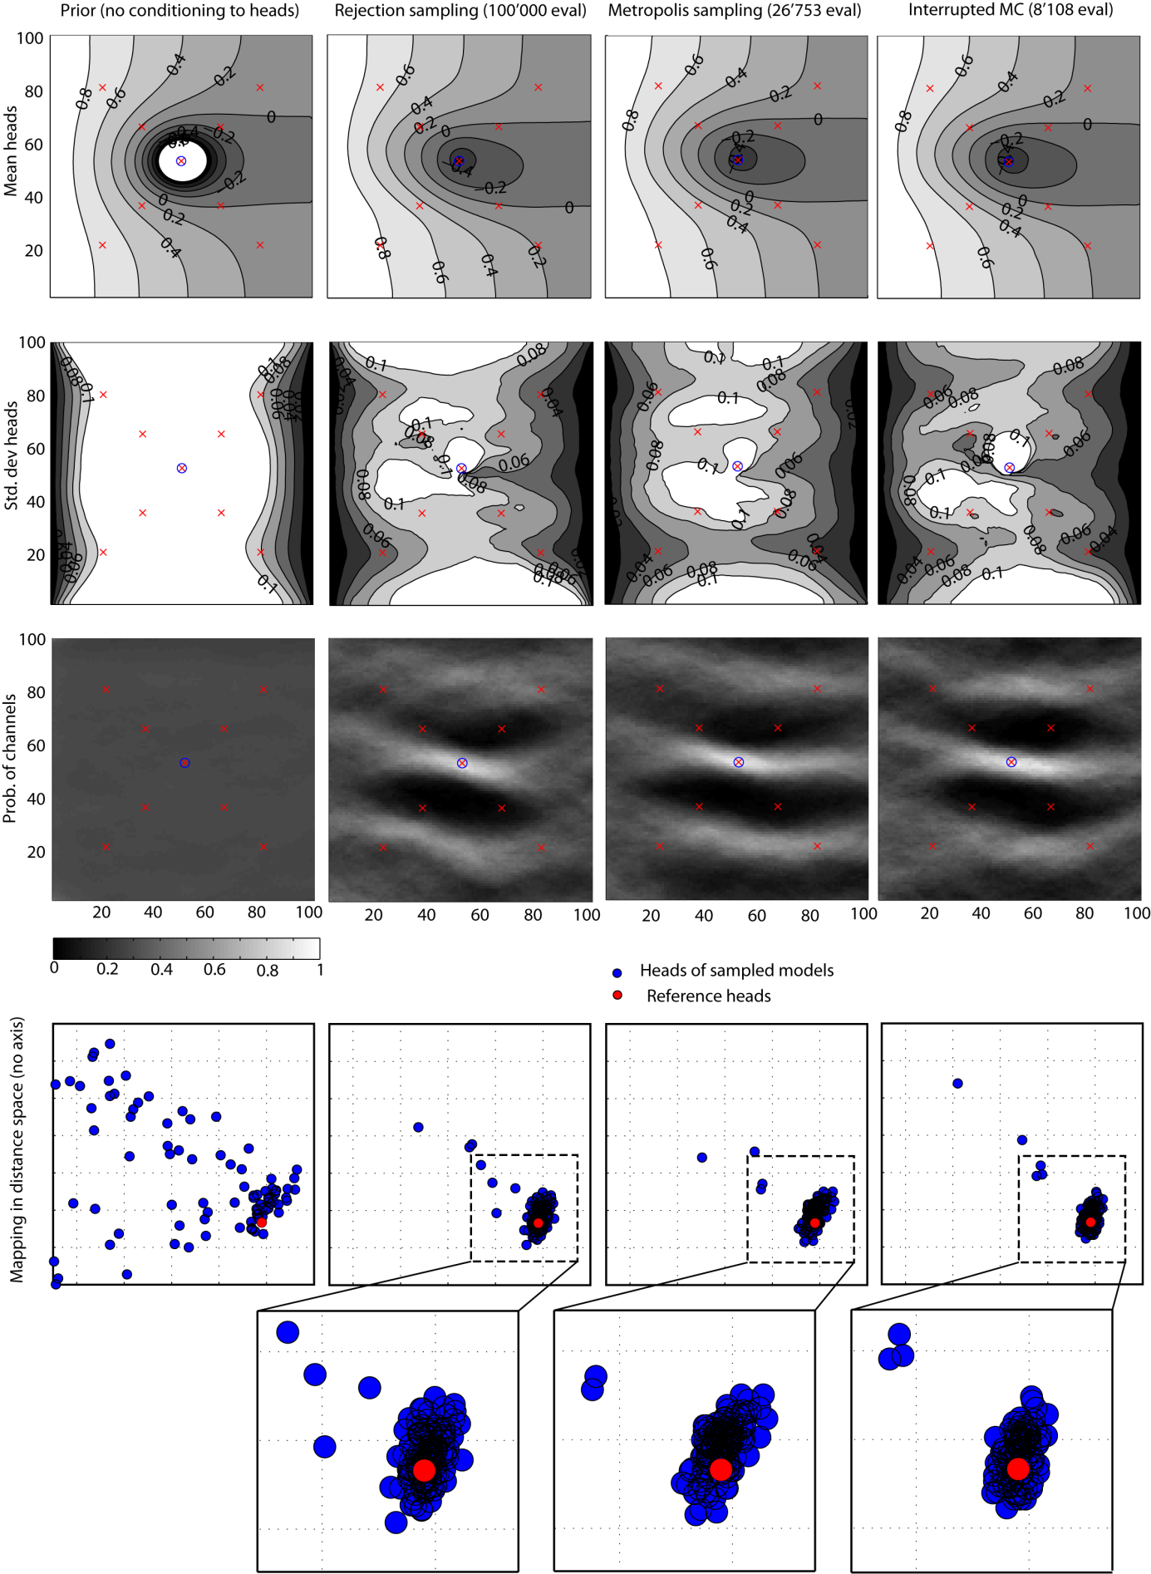
Ensemble averages
EA prior Earth models
EA pressure
ESD pressure
EA = Ensemble Average
ESD = Ensemble Standard Deviation

Slide 58
Rejection sampler: no data error
Generate a (prior) Earth model m consistent with any prior information
Evaluate g(m)
If g(m)=d, then keep that model, else reject it
Go to step 1 until a desired amount of models has been found

Slide 59
Rejection sampler: data error

Slide 60
Rejection sampler: data error
Generate a (prior) Earth model m consistent with any prior information
Evaluate g(m)
Accept the model m with probability p=P(M=m|D=d)
Go to step 1 until a desired amount of models has been found

Slide 61
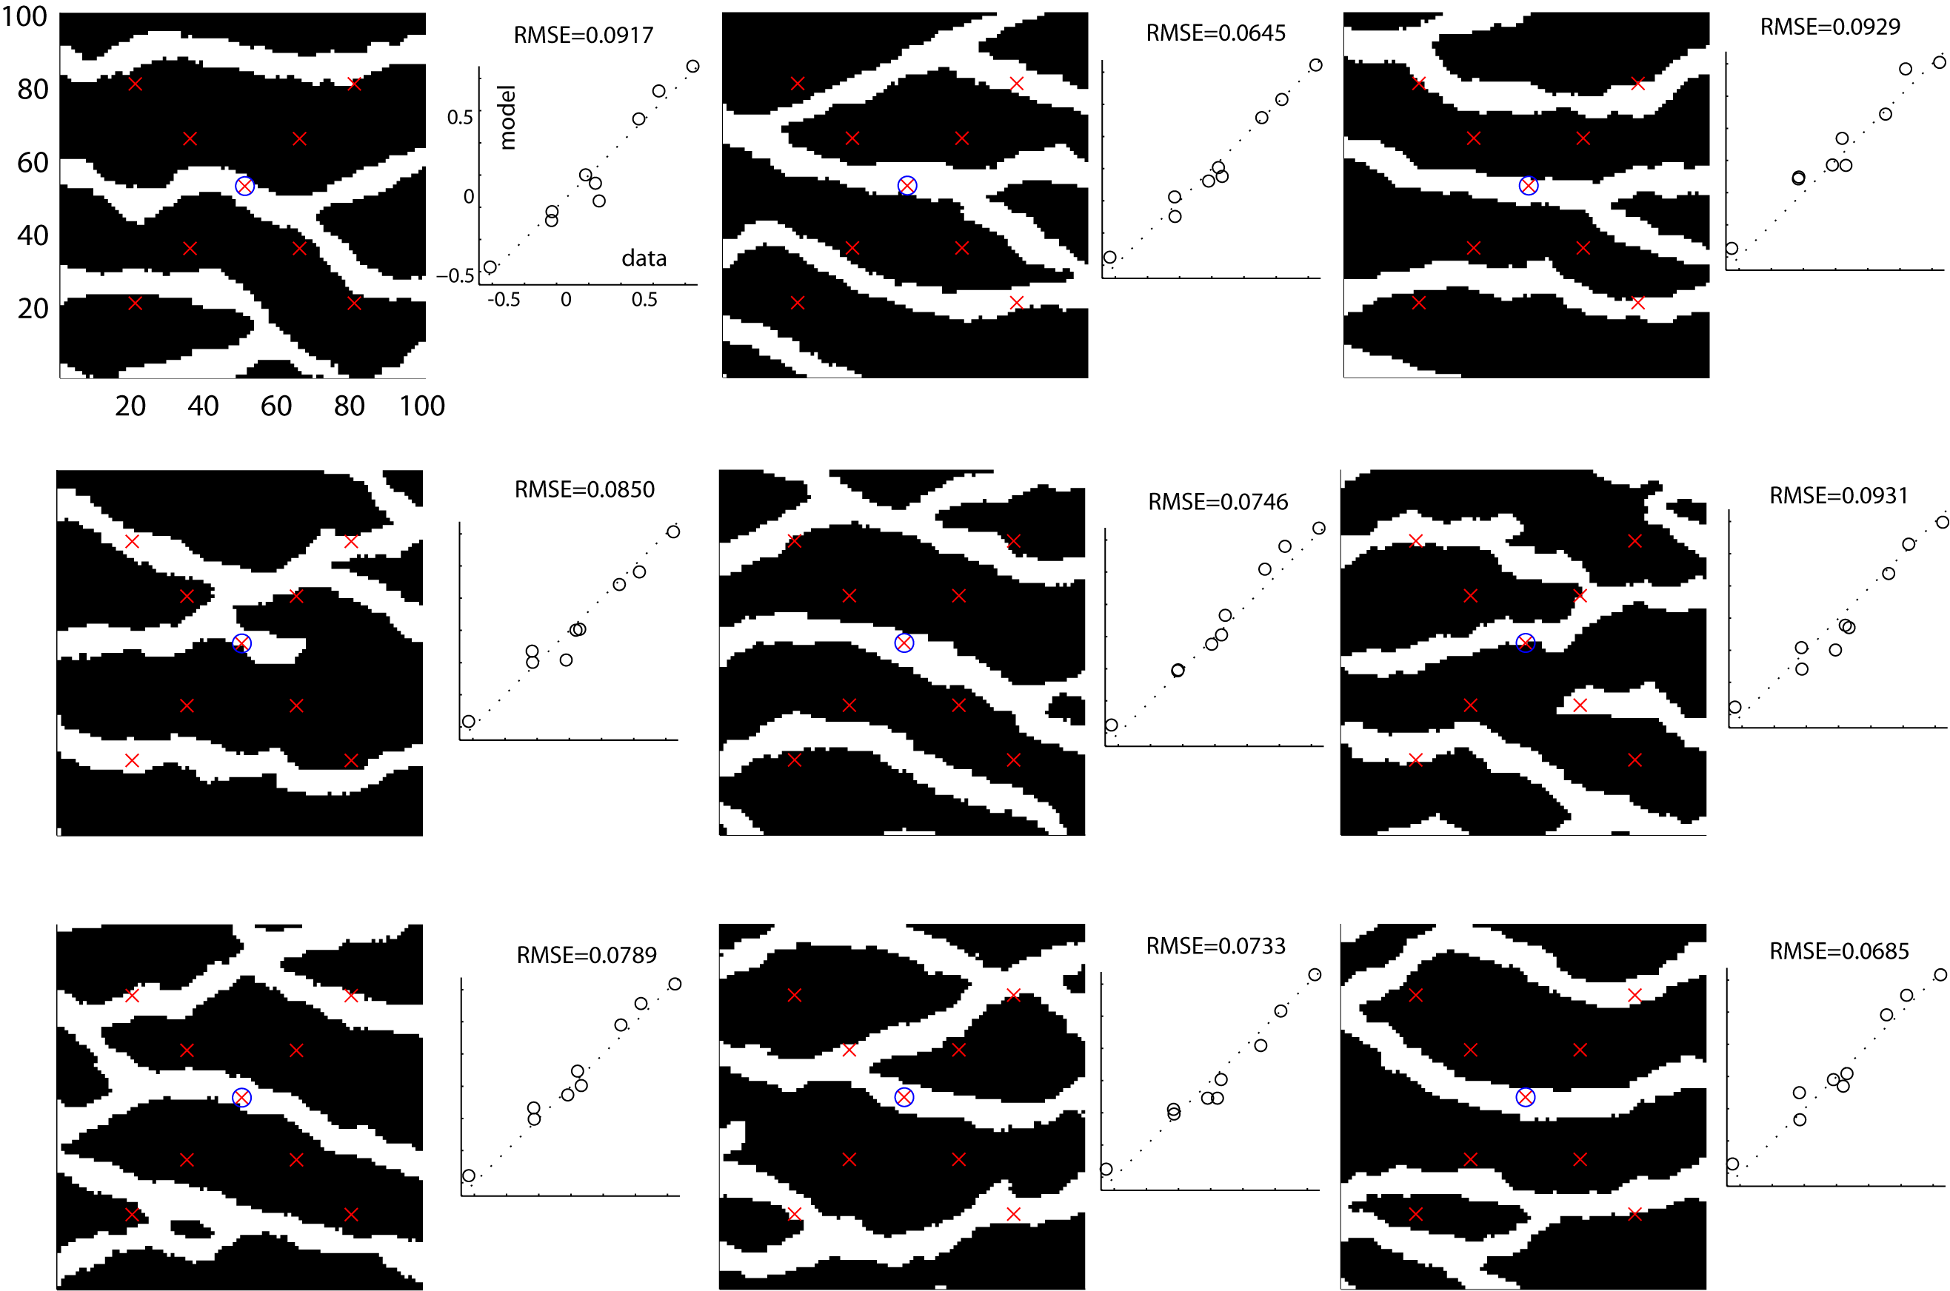
Conditional models
Posterior Earth models

Slide 62
Results
rejection
100.000 evals
prior
EA
(Ensemble average)
ESD
(Ensemble std dev)
Probability of
channel occurring

Slide 63
Metropolis sampler
Generate a (prior) Earth model m
Propose a change to m, but make sure this change is still consistent with any prior information. Call this change m*
If P(D=d | M=m) < P(D=d | M=m*) then
accept m* (call m now m*)
else accept m* with probability p
Go back to step 2 and iterate “until convergence”

Slide 64
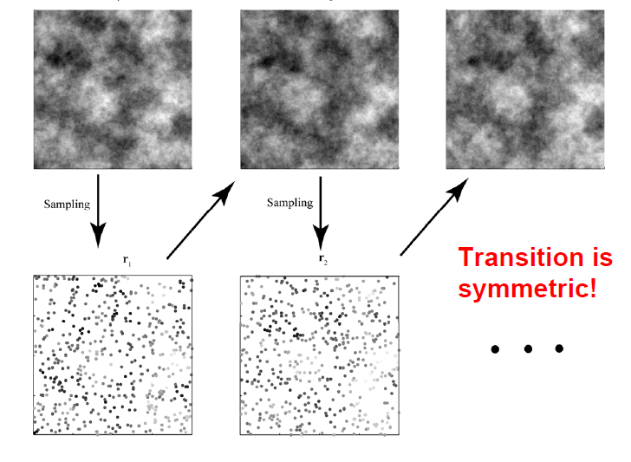
Example of a gradual change

Slide 65
Prior model
(no data)
Rejection sampling
(100.000 evals)
Metropolis sampling
(8108 evals)
EA
(Ensemble average)
ESD
(Ensemble std dev)
Probability of
channel occurring

